Slide 1

WELCOME
TO
SPRINT ASSESSMENT
ON
BINARY BUDDY ALGORITHM
Capgemini
GUIDED BY
SANDEEP YADAV
(TRAINER)
PRESENTED BY :-
SHIKHA BHASKAR (TEAM LEADER)
SIMRAN ANAND
NISHU KUMARI
AYUSHI SINGH
MITALI SARAF
SONI KUMARI

Slide 2
CONTENT
INTRODUCTION
TOOLS
FLOW CHART
WORKING
ADVANTAGES
DISADVANTAGES
CONCLUSION
OUTPUT

Slide 3
INTRODUCTION
The Buddy memory allocation technique is a
memory allocation algorithm that divides memory
into two equal small partitions.
What is a buddy?
The two smaller parts of blocks are of equal size is
known as buddies.

Slide 4
Types of Buddy System
There are 4 types of Buddy System. They are:
Binary Buddy system
Fibonacci Buddy system
Weighted Buddy system
Tertiary Buddy system

Slide 5
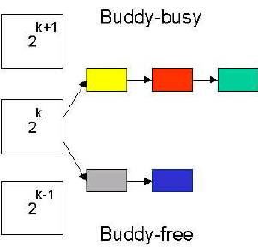
What Is Binary Buddy System?
The memory consists of a collection of blocks of consecutive memory, each of which is a power of two in size.
Each block is marked either occupied or free, depending on whether it is allocated to the user.
The system provides two operations:-
1.Allocate : Finds a free block of size 2^k, marks it as occupied, and returns a pointer to it.
2.Deallocate : Marks the previously allocated block B as free and may merge it with others to form a larger free block.

Slide 6

TOOLS
Ubuntu
G++ Compiler
VI EDITOR

Slide 7
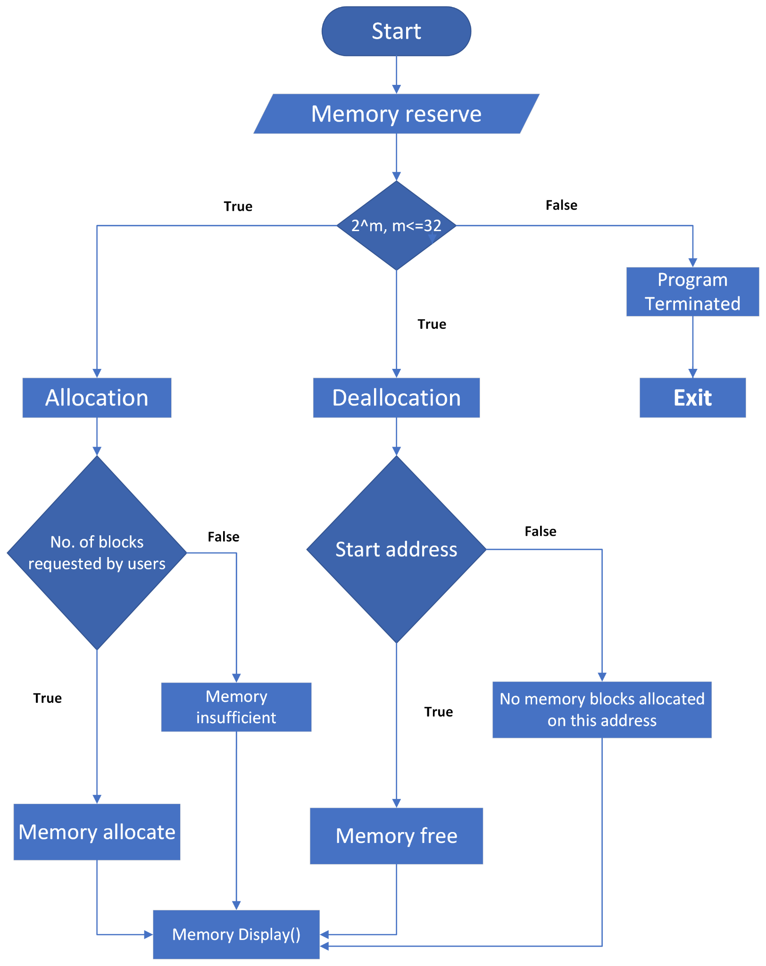
FLOW CHART
.

Slide 8
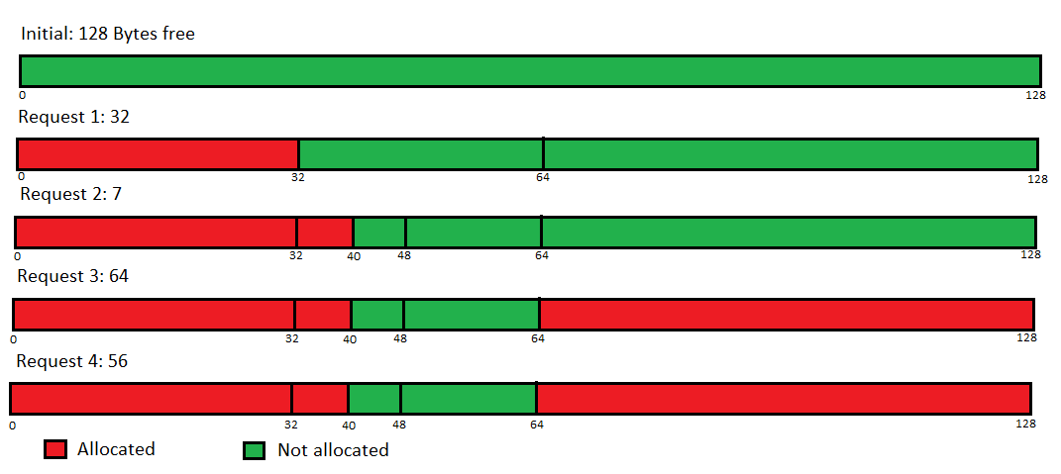
WORKING FOR ALLOCATION

Slide 9
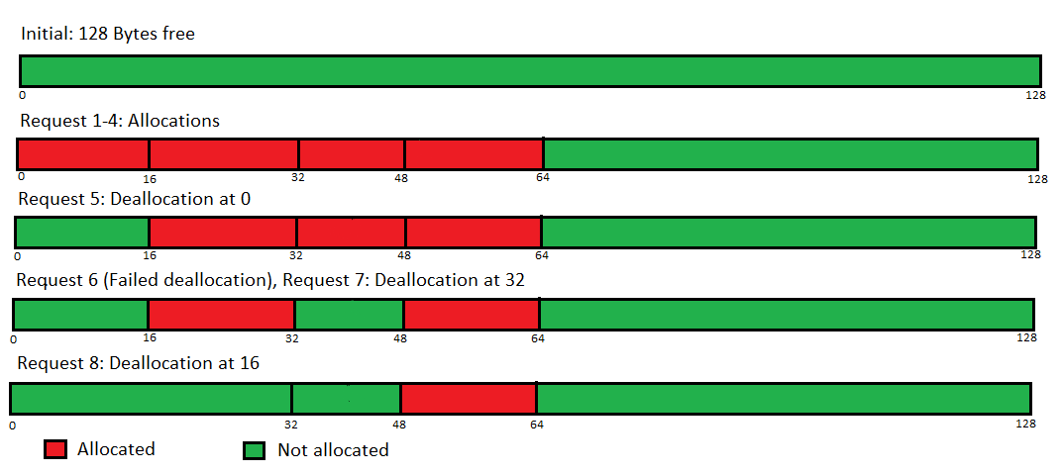
WORKING FOR DEALLOCATION

Slide 10

ADVANTAGES
Easy to implement a binary buddy system
Allocates block of correct size
It is easy to merge adjacent holes
Fast to allocate memory and deallocate memory

Slide 11

DISADVANTAGES
It requires all allocation units to be powers of two.
It leads to internal fragmentation.

Slide 12

CONCLUSION
After going through this topic we came to a conclusion
that Binary Buddy algorithm is a technique in which
Memory blocks get divided into two equal parts to try
to satisfy a memory request as suitable as possible.

Slide 13
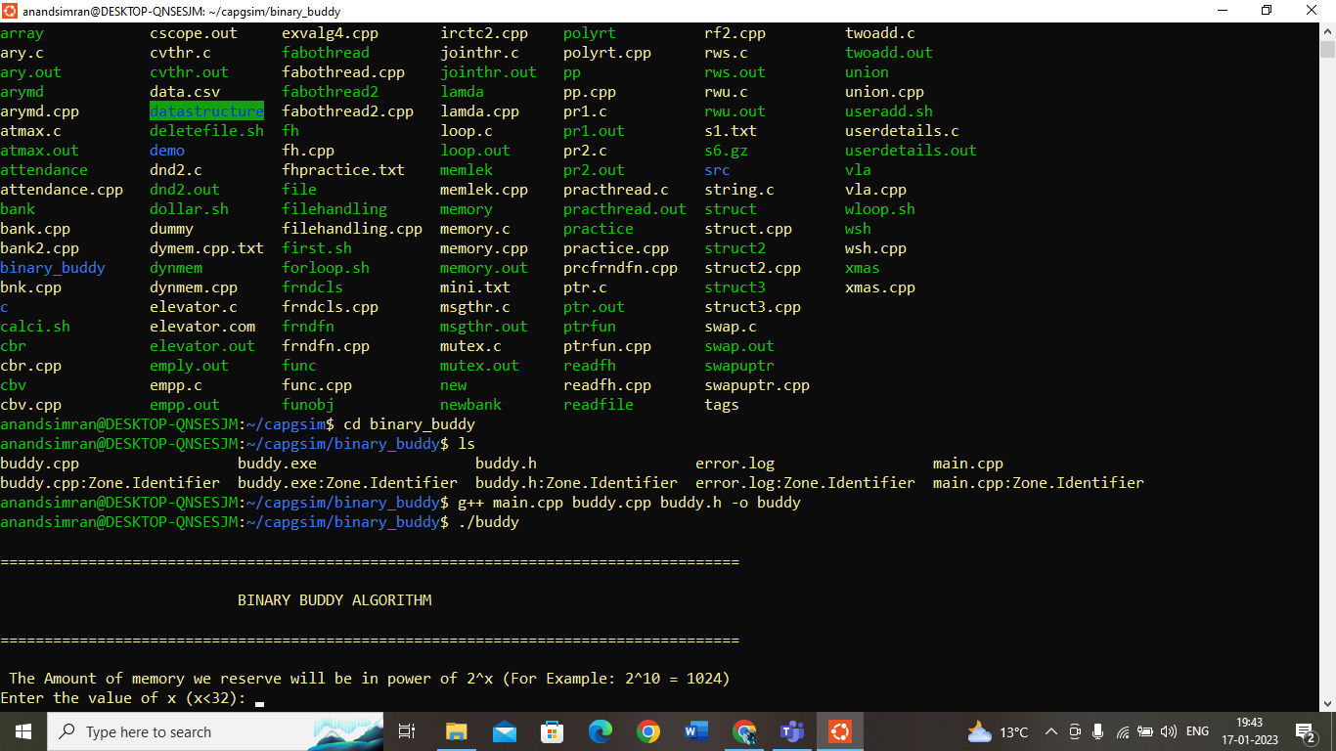
OUTPUT

Slide 14
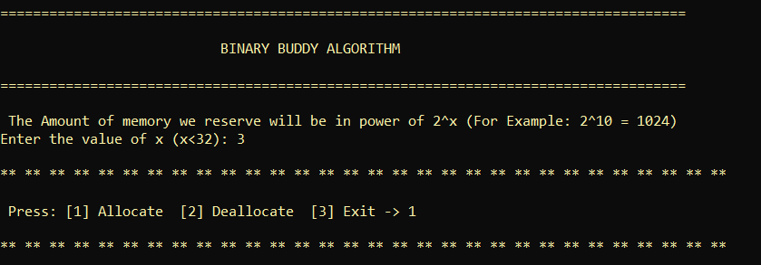
Memory Reserved 2^3

Slide 15
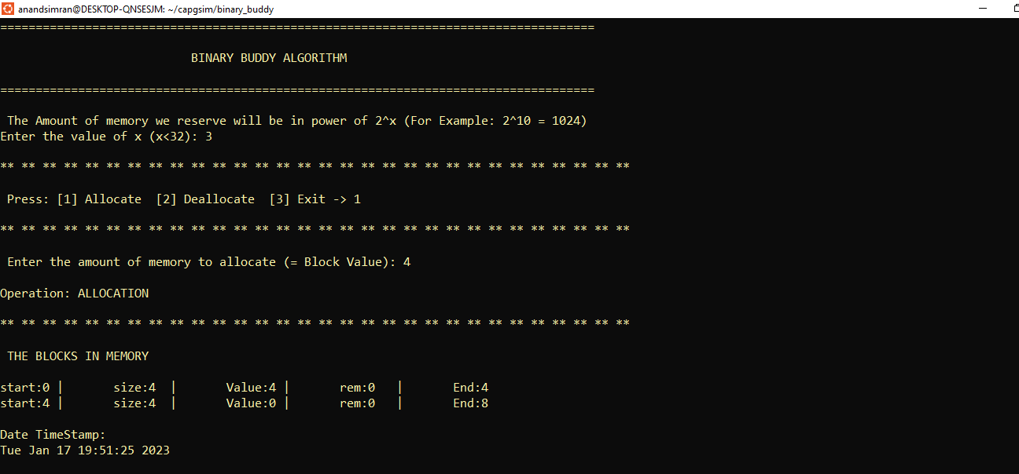
For Allocation Press 1

Slide 16
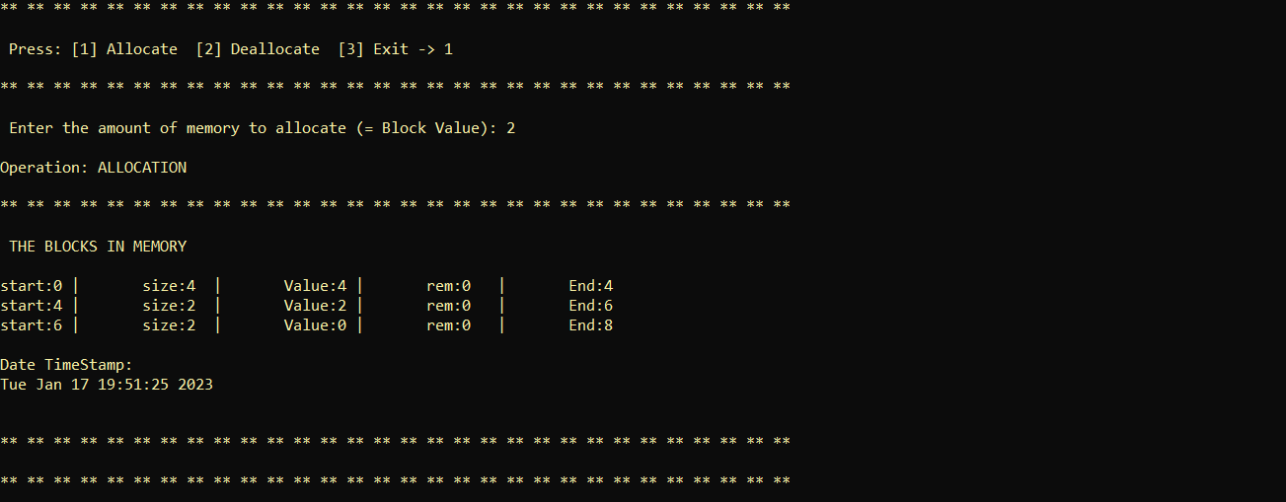
If user wants to allocate more blocks

Slide 17
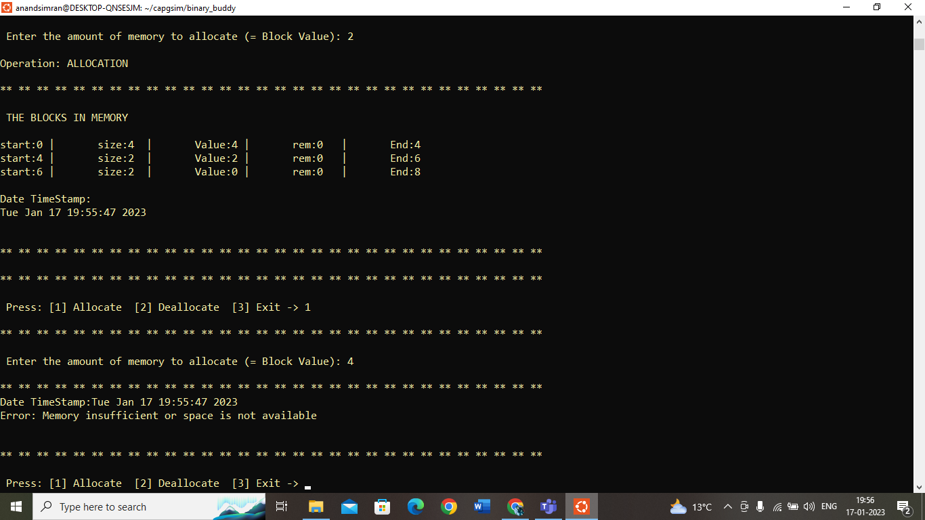
If user enters block size greater than remaining size

Slide 18
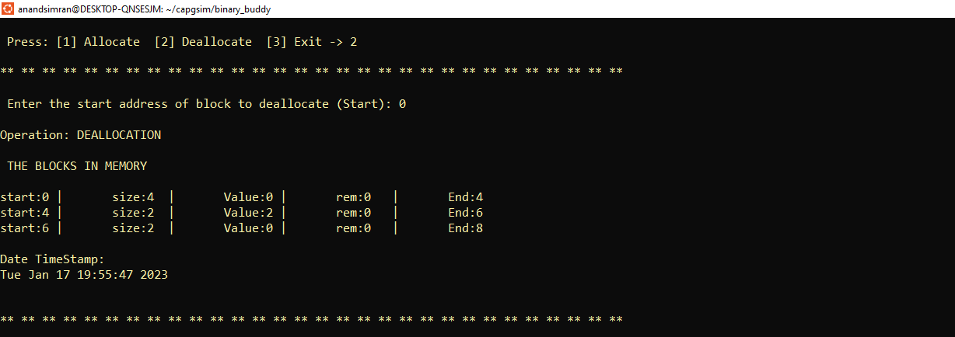
For Deallocation Press 2

Slide 19
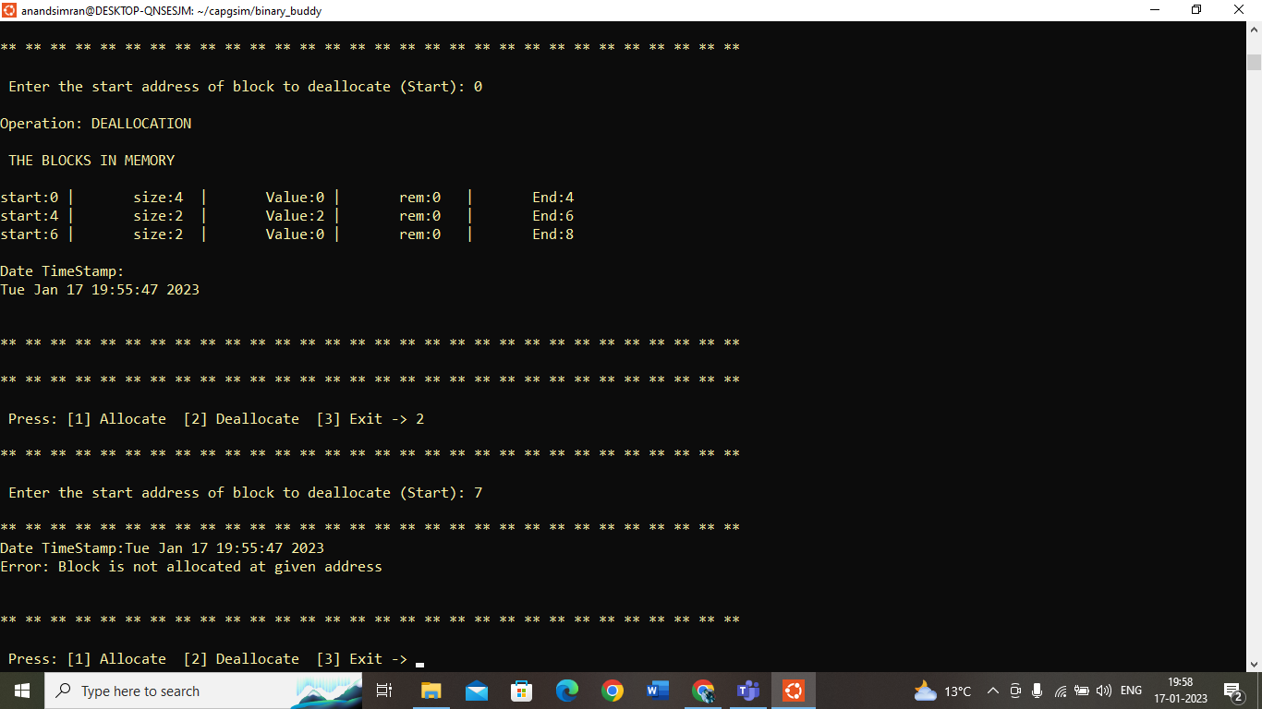
If user passed incorrect starting address

Slide 20
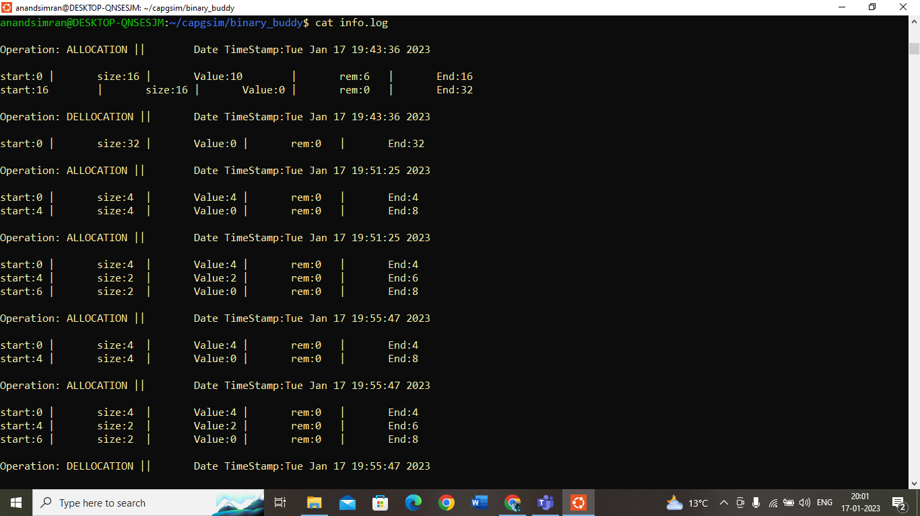
cat info.log file

Slide 21
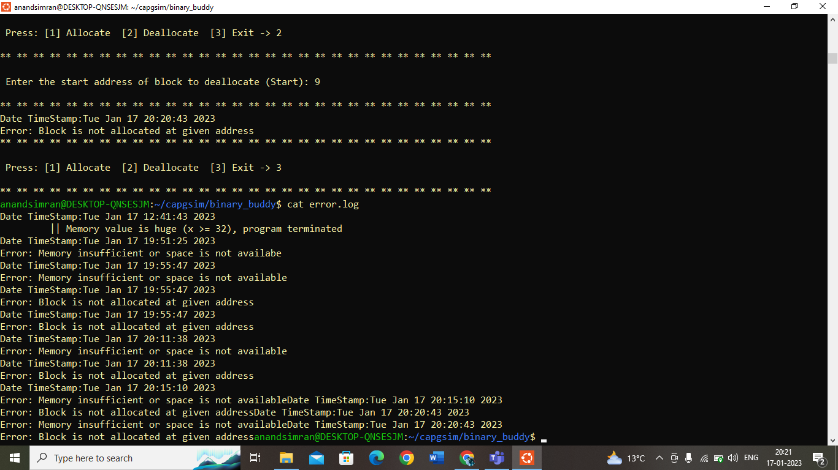
cat error.log file

Slide 22
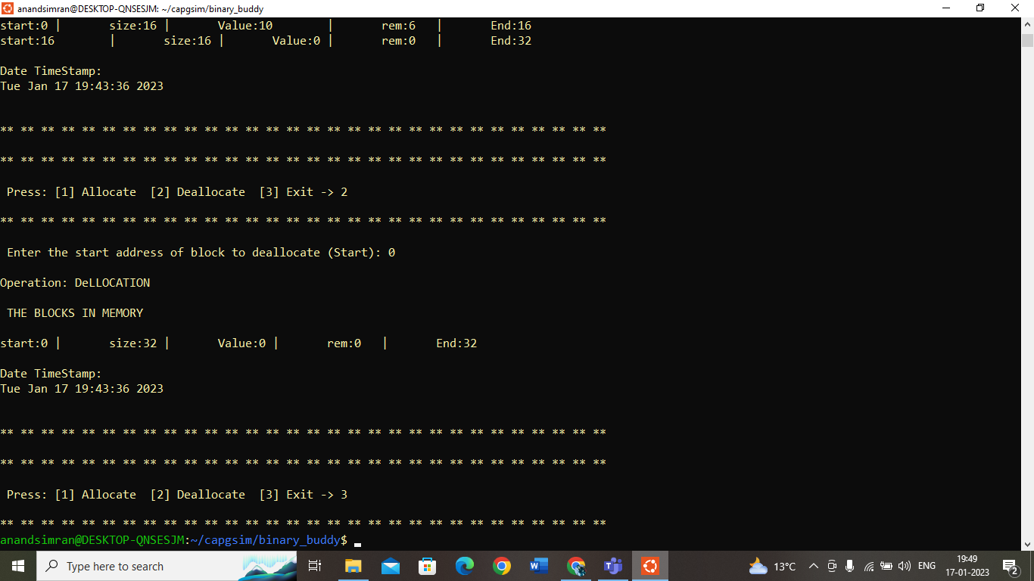
Press 3 to exit

Slide 23


